Slide 1

LINEAR ALGEBRA
SRI HARI DEGREE COLLEGE
(Permanently Affiliated to Yogi Vemana University, Kadapa)
Recognized by UGC New-Delhi under Section 2(f) &12(8)
An ISO 9001:2015Certified Institution
#45/290-10,BalajiNagar,Kadapa,A.P.,INDIA-516003
E-Mail:sriharidc047@gmail.com Web www.sriharidegreecollege.ac.in ©9440074132
prepared
by
DR.V.SUBBAREDDY (H.O.D)
Dept.of Mathematical Sciences

Slide 2
Rank of a Matrix
Sub matrix
A matrix which is obtained by deleting some rows or columns or both from a given matrix is said to be its sub matrix.
Ex. Given A =
(By deleting 3rd row and 4th column)
(By deleting 3rd row from A) etc., are the sub matrices of A.
1

Slide 3
Minors of Matrix
Let A be an m×n matrix. The determinant of a square sub matrix of A is said to be the minor of the matrix A.
Ex.: Let A =
This matrix has 3 – rowed, 2–rowed and 1 – rowed minors.
i.e.
etc., are 3 – rowed minors of A
etc., are 2 – rowed minors of A
Each element of the matrix is called 1 – rowed minors of A

Slide 4
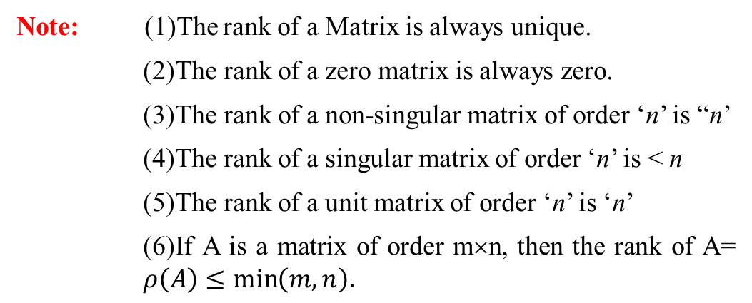

Rank of a Matrix
The order of the non – vanishing minor is called the rank of a matrix or In other words a positive number r is said to be the rank of a matrix A if
(i) There exists at least one r–rowed minor, whose value is ≠ 0 and
(ii) Every (r + 1) – rowed minor of A is zero.
Rank of a matrix A is denoted by $ρ(A)$
Note: (1)The rank of a Matrix is always unique.
(2) The rank of a zero matrix is always zero.
(3) The rank of a non-singular matrix of order ‘n’ is “n’
(4) The rank of a singular matrix of order ‘n’ is < n
(5) The rank of a unit matrix of order ‘n’ is ‘n’
(6) If A is a matrix of order m×n, then the rank of A= $ρ\left(A\right)≤\min\left(m,n\right).$

Slide 5

Solved Examples:
Find the rank of each of the following matrices.
(i)
(ii)
(iii)
Sol.:(i) Let A =
This matrix has 3 – rowed, 2 – rowed and 1 – rowed minors.
= 1(2 – 0) – 2(4 – 0) + 3(2 – 0)
= 2 – 8 + 6= 0
i.e A is singular ⇒$ρ\left(A\right)<3$
There is at least one 2–rowed minor i.e
= 1 – 4 = – 3 ≠ 0.
Hence the rank of A =2

Slide 6

(ii) Let A =
This matrix has 2 – rowed and 1 – rowed minors. There is at least one 2 – rowed minor i.e
= 12 – 4 = 8 ≠ 0.
Hence the rank of A =2
(iii) Let A =
This matrix has 3 – rowed, 2 – rowed and 1 – rowed minors.
All 3 – rowed and 2 – rowed minors of A are zero.
Hence $ρ\left(A\right)=1$

Slide 7
Elementary Transformations
There are three types of elementary transformations (operations).
(i) Interchange of any two rows (columns).
Thus the interchange of i^{th} row (column) and j^{th} row (column). Symbolically it is denoted by R_{i} ↔ R_{j} (or)C_{i} ↔ C_{j}
(ii) Multiplication of each element of a row (column) with a non – zero scalar.
Thus the multiplication of i^{th} row (column) by a non – zero scalar k is symbolically denoted by R_{i} → k R_{i} (or) C_{i} → kC_{i}
(iii) The addition of the elements of a row (column) with the corresponding elements of any other row (column) which is multiplied by a non–zero scalar.
Thus the addition of the elements of i^{th} row (column) to the corresponding elements of the j^{th} row (column) which is multiplied by a non – zero scalar k.
Note: Elementary transformations does not change the rank of a matrix

Slide 8

Echelon form or Triangular form of a matrix
A matrix is said to be in Echelon form or Triangular form if the following three properties are satisfied.
(i) Zero rows, if any, must be below the non – zero rows.
(ii) The first non-zero element of a non-zero row is equal to unity (1)
(iii) The number of zeros before the non – zero element of a row is less than such zeros in the next row.
Note: – Condition (ii) is not compulsory.
After reducing the matrix A to Echelon form, the number of non – zero rows gives the rank of the matrix.
Ex.:The matrix A =
is in Echelon form, since it satisfies all the three conditions of the Echelon form
So $ρ\left(A\right)=$ The number of nn-zero rows of A = 3

Slide 9
1. Reduce the following matrices into Echelon form and determine the rank of the matrix.
(i)
(ii)
Sol.: (i)
Let A=
Applying R₁ ↔ R₃, we have
Applying R₃ → R₃ – 5R₁, we have
A ~
A ~
Applying R₃ → R₃ – 8R₂, we have
1

Slide 10
A ~
which is in Echelon form
Here the number of non – zero rows is 3
Hence ρ(A) = 3
Applying R₂ → R₂ – 2R₁,
R₃ → R₃ → 3R₁ and
R₄ → R₄ – 6 R₁, we have
Sol(ii):
Let A =
A ~
Applying R₂ ↔ R₃, we have
Applying R₄ → R₄ – R₃, we have
A ~
2

Slide 11
which is in Echelon form
A ~
Here the number of non-zero rows of the equivalent matrix is 3
Hence ρ(A) = 3
2. Reduce the following Matrix to Triangular form and determine it’s rank.
Sol:
Let A =
Applying R₃ → R₃ – R₁,
R₄ → R₄ – R₁, we have
3

Slide 12
A ~
Applying R₄ → R₄ – 2R₂ , we have
A ~
Applying R₃ → 3R₃ – 4R₂, we have
A ~
which is in Echelon form.
Hence ρ(A) = The number of non-zero rows of the last equivalent – matrix of A = 3

Slide 13
3. Find the rank of following matrix by reducing into Echelon form.
Applying R₂ → R₂ + R₁ ;
R₃ → R₃ + 2R₁ ;
R₄ → R₄ – R₁ , we have
Sol:
A ~
Applying R₃ → 2R₃ – 11R₂,
R₄ → R₄ + 2R₂, we have
A ~
Applying R₄ + 6R₄ + R₃, we have

Slide 14
A ~
which is in Echelon form
Hence ρ(A) = the number of non – zero runes of the last equivalent matrix of A
= 4
4. For what value of k the
matrix A =
has rank 3.
Sol:
Let A =
Applying R₁ ↔ R₂, we have
Applying R₂ → R₂ – 4 R₁,
R₃ → R₃ – kR₁,
R₄ → R₄ – 9R₁, we have
A ~

Slide 15
A ~
Since the given matrix is of rank 3, then it’s 4-rowed miner is zero. i.e. det A=0.
Expanding by C₁, we have
Again expanding by C₁, we have

Slide 16
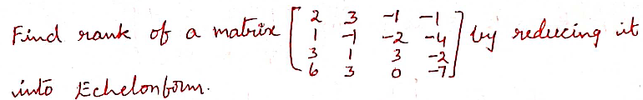
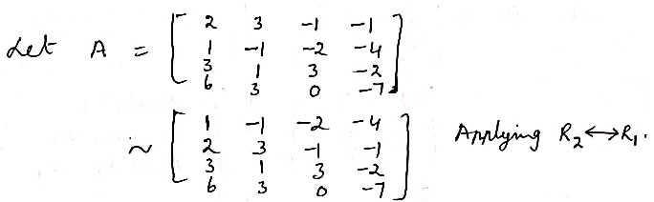
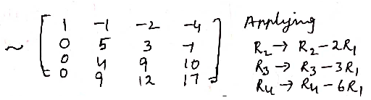

Slide 17
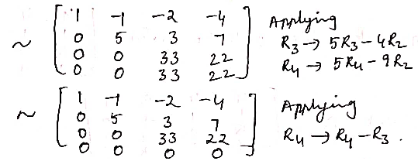

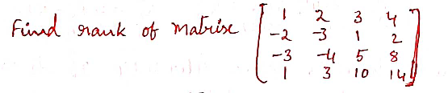
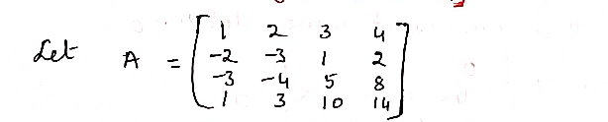

Slide 18
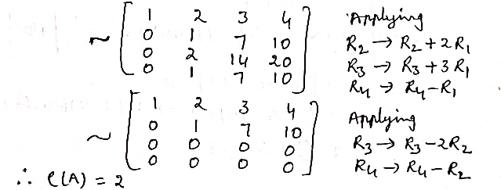



Slide 19
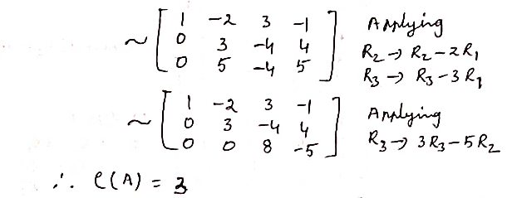

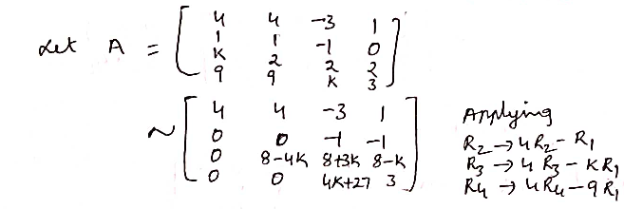

Slide 20
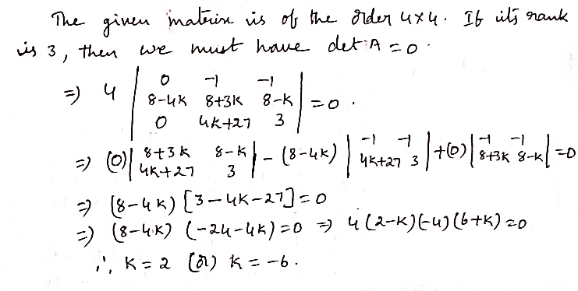
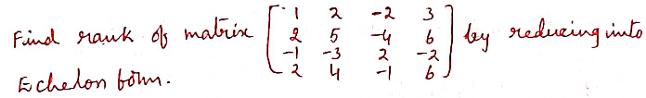
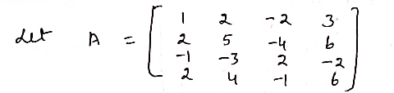

Slide 21
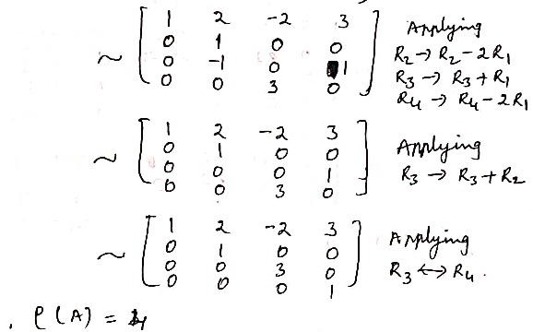
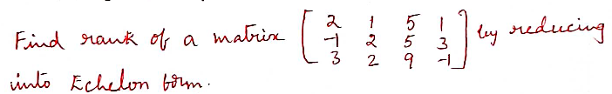

Slide 22
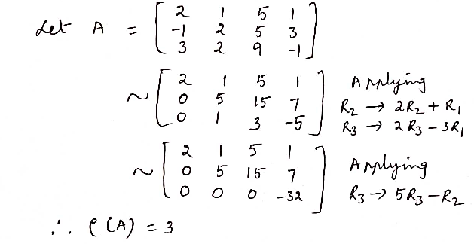
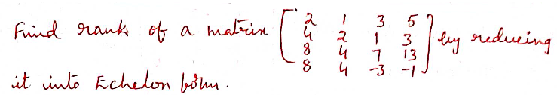
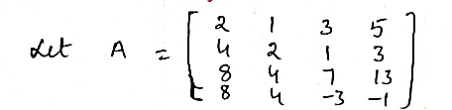

Slide 23
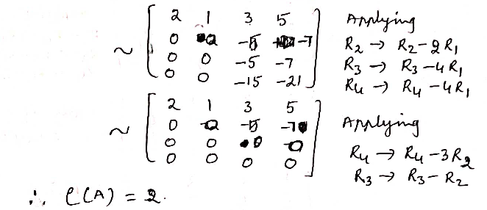

Slide 24
Normal form or canonical form of a Matrix
If an m × n matrix can be reduced to the form
by using a finite chain of Elementary transformations, where I_{r} is the r –rowed unit matrix, then the above form is called “The normal form” or “The first canonical form” of a Matrix
Here r indicates the rank of a matrix. The various normal forms are
etc.

Slide 25
Problems on Normal form
1. Find the rank of the matrix
by reducing to normal form.
Sol.
Let A =
Applying R₁ ↔ R₃, we have
Applying R₂→ R₂ – 4R₁,
R₃ → R₃ – 2R₁and
R₄ → R₄ – R₁, we have
A ~
Applying C₂ → C₂ + C₁,
C₄ → C₄ – 3C₁, we have
A ~

Slide 26
A ~
Applying R₄ → 6R₄ + R₂, we have
Applying C₄ → 3C₄ + 5c₂, we have
A ~
A ~
Applying C₄ → C₄ + 8C₃, we have
A ~
Applying R₂ → R₂ /6; R₄ → R₄ /6

Slide 27
A ~
Applying R₃ ↔ R₄ , we have
A ~
Which is the normal form of the matrix A.
Hence rank of the matrix A = ρ(A) = 3
2. Reduce the matrix A =
into the normal form and determine its
rank.
Sol.:
Given A =
Applying R₂ → R₂ – 4R, we have

Slide 28
A ~
Applying C₂→C₂ + C₁,
C₃ → C₃ – 2C₁ and
C₄ → C₄ + 3C₁, we have
Applying R₂ ↔ R₄, we have
A ~
Applying R₃ → R₃ – 3R₂,
R₄ → R₄ – 5R₂, we have
A ~
Applying C₄ → C₄ – 2C₁, we have
A ~

Slide 29
A ~
Applying R₃ ↔ R₄, we have
A ~
Applying C₄ → 2C₄ + C₃, we have
Applying R₃ → R₃ /-8,
R₄ → R₄ /-4
A ~
A ~
which is the normal form of the matrix A.
Hence ρ(A) = 4

Slide 30
3. Reduce the matrix
into canonical form and hence determine its rank.
Sol.: let A =
Applying R₁ ↔ R₃, we have
Applying R₃ → R₃ – 3R₁, we have
A ~
Applying C₂→C₂+2C₁,
C₃ → C₃ + 3C₁ and
C₄ → C₄ – 2C₁, we have
A ~

Slide 31
Applying R₃ → R₃ – 2R₂,
R₄ → 2R₄ – R₂, we have
A ~
Applying C₃ → C₃ – C₂ and
C₄ → 2C₄ – C₂, we have
A ~
Applying R₄ → 5R₄ – 2R₃, we have
A ~
Applying C₂ → C₂ /2;
C₃ → C₃ /5
A ~

Slide 32
A ~
Applying C₄ → C₄ + 9C₃, we have
Applying C₄ → C₄ /23
A ~
A ~
which is the canonical form of the matrix A.
Hence ρ(A) = 4

Slide 33
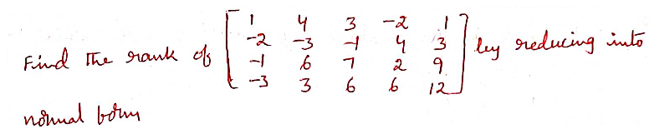
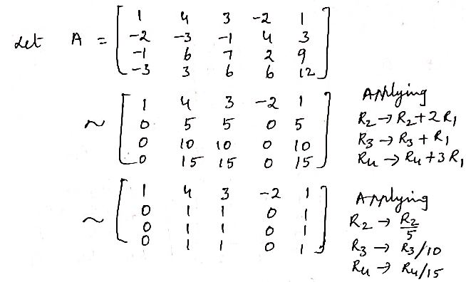

Slide 34
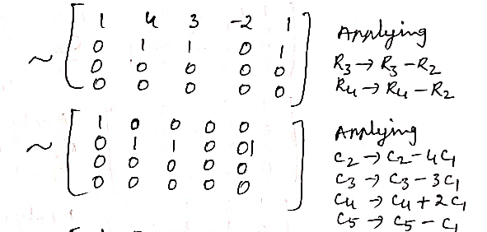
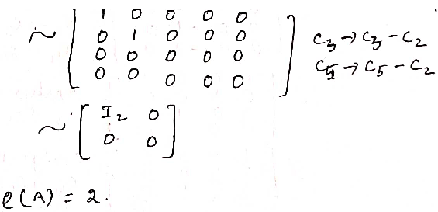

Slide 35
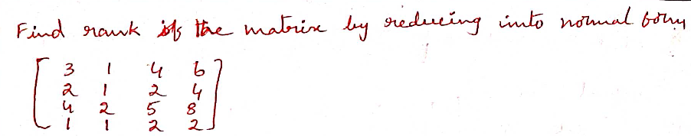
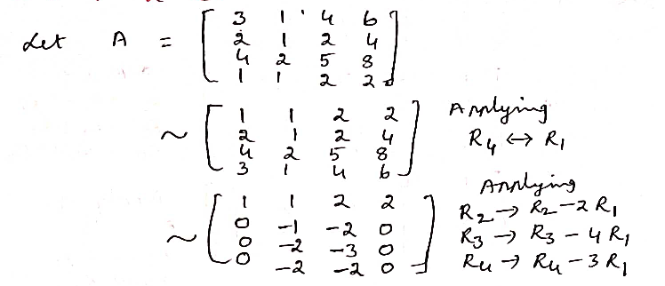

Slide 36
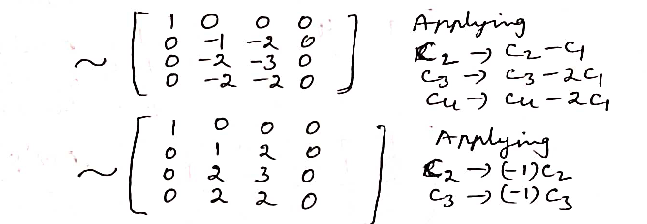
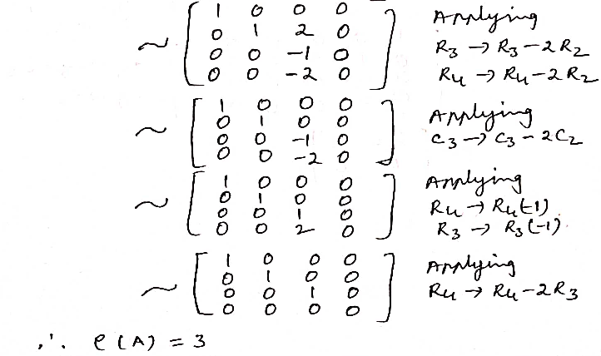

Slide 37

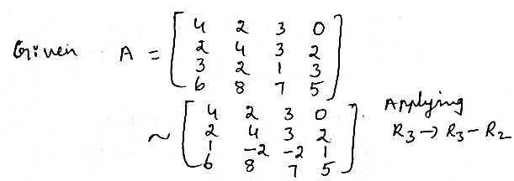
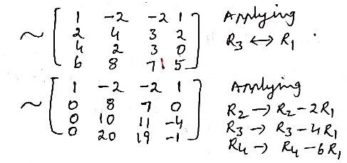

Slide 38
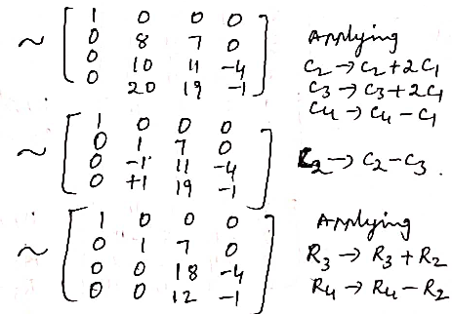
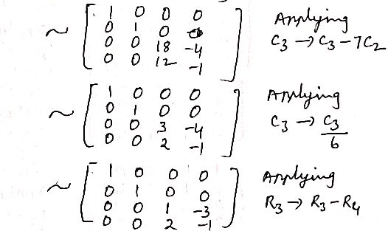

Slide 39
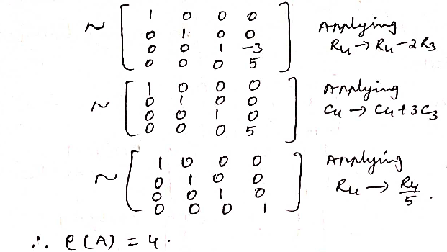
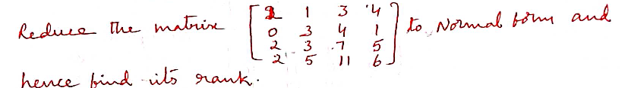


Slide 40
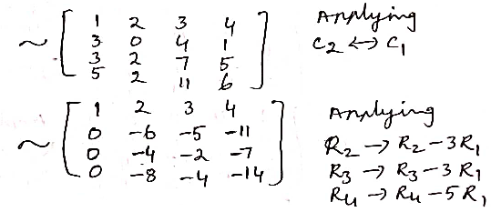
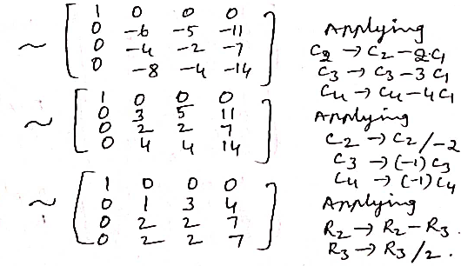

Slide 41
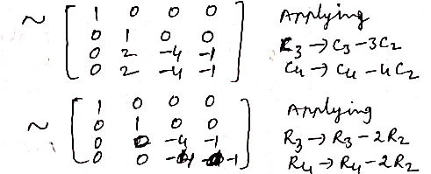
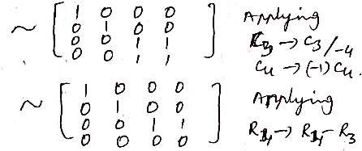
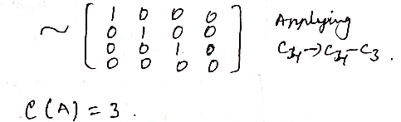

Slide 42
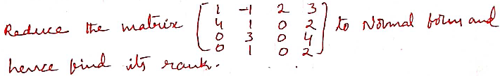
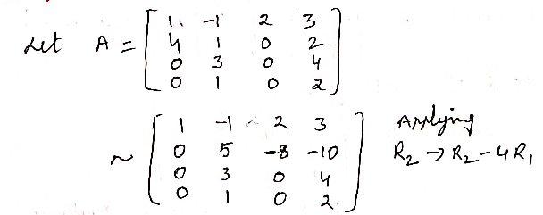
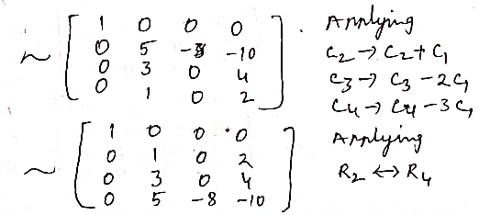

Slide 43
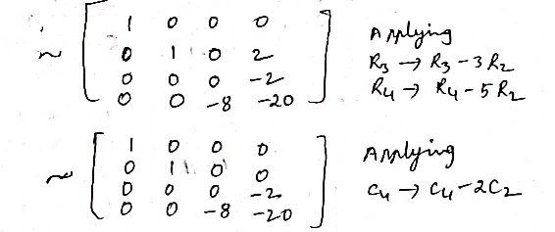
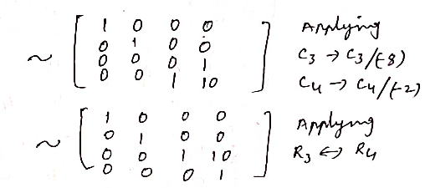
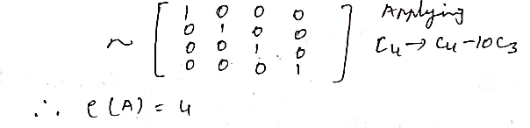

Slide 44
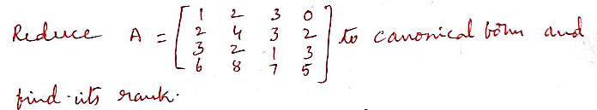
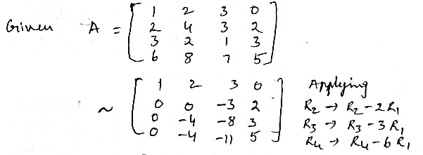
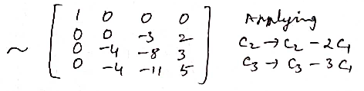
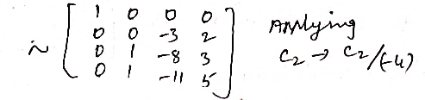

Slide 45
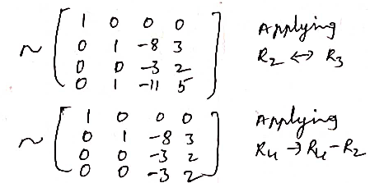
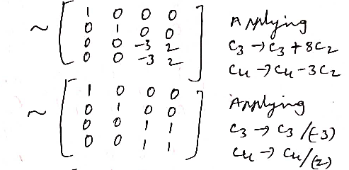


Slide 46




Slide 47




Slide 48




Slide 49




Slide 50





Slide 51
Solution linear systems
In this chapter we study the nature of solution of a system of linear equations with the help of rank and its related procedures. We shall first consider system of homogeneous linear equations and then proceed to discuss the system of non–homogeneous linear equations.
1. Homogeneous linear equations
A set of equations of the form
is said to be a system of ‘m’ homogeneous equations in n unknowns x₁, x₂,…….x_{n}. Then obviously we can write the above system of equations (1) in the form of a single matrix equation given by AX = 0…….(2),

Slide 52
is the matrix of unknowns and
is the null matrix of the system of equations (1)
Note:1) The solution x₁ = x₂ = …= x_{n} = 0 i.e

Slide 53
is called a solution of (1) and it is said to be the trivial solution (zero solution) of the system of homogeneous equations AX = 0.
2) Always the system of homogeneous equations consistent i.e it contains a solution.
3) Always a system of homogeneous linear equations i.e AX = 0 contains ‘n – r’ linearly independent solutions. Where r being the rank of the coefficient matrix A and n being the number of variables of the system.
4) The Trivial solution X = 0 is not linearly independent and it is a linearly dependent solution.
Nature of solutions of AX = 0:
Suppose we have m equation in n unknowns. Then the coeffici-ent matrix A will be of order m × n. Let r be the rank of the matrix A. obviously r cannot be greater than n (the number of columns of the matrix A). Therefore we have either r = n or r < n.

Slide 54

Case 1: If r = n, then the given system of equations AX = 0 will have n – r = n – n = 0 linearly independent solutions. So in this case the given system possesses a linearly dependent solution i.e only a trivial solution [zero solution]
Case 2: If r < n, then the given system of equations AX = 0 contains ‘n – r’ linearly independent solutions. Any linear combination of these solutions will also be a solution of AX = 0. Thus in this case the given system AX = 0 contains an infinite number of solutions.
Case 3: Suppose m < n i.e the number of equations less than the number of unknowns. Since r$≤$ m, therefore r is definitely less than n. Hence in this case the given system of equations must possess a non-zero solution. So that the number of solutions of the system AX = 0 will be infinite.
Working procedure
Step 1: First write the matrix equation of the given system of equations.
Step 2: Reduce the coefficient matrix A to Echelon form and determine the rank of A. Let r be the rank of the coefficient matrix A of order m × n and n be the number of variables or unknowns of the given system of equation A X = 0.

Slide 55


Step 3: Now we have to verity the following cases
(i) If r = n, then the given system of equations AX = 0 possesses only a trivial solution (zero solution) i.e x₁ = x₂ …..= x_{n} = 0 or X = 0.
(ii) If r < n, then the given system of equations possesses an infinite number of solutions. Of these solutions, (n– r) solutions are linearly independent and the remaining are depending upon them. So, we have to assign arbitrary values for (n–r) variables, and the remaining variables are depending upon them.
If m < n, then since r $≤$ m<n, here also the given system possesses an
infinite number of solutions.
Note: 1. If A is a non-singular matrix i.e $\left|A\right|≠0$ then the linear system AX=0 has only a trivial solution (zero solution)
If A is a singular matrix i.e $\left|A\right|=0$ then the liner system AX = 0 contains a non– zero solution i.e we get on infinite number of solutions.

Slide 56
Solved Examples
Ex.1. Solve completely the system equations
x + y – 3z + 2w = 0
2x – y + 2z – 3w = 0
3x – 2y + z – 4w = 0
– 4x + y – 3z + w = 0
Sol.: The matrix equation of the given system of equations is AX = 0

Slide 57
Now we have to reduce the coefficient matrix A to Echelon form by applying E – row transformations only and determine the rank of A.
Applying R₂ → R₂ – 2R₁; R₃→ R₃ – 3R₁,; R₄ → R₄ + 4R_{1,} we have
Applying R₃ → 3R₃ – 5R₂;
R₄ → 3R₃ + 5R₂; we have
A ~
A ~
Applying R₄ → 2R₄ – R₃, we have
A ~

Slide 58
Here the rank of A = r = The number of non–zero rows of equivalent matrix A = 4.
i.e. r = 4 = n i.e. the number of unknowns of the system.
Hence the given system of equations contains only a trivial solution
∴ x = y = z = w = 0 is the only solution of the given system of equations.
Ex.2. Solve completely the system of equations
x – 2y + z – w = 0, x + y – 2z + 3w = 0;
4x + y – 5z + 8w = 0 and 5x – 7y + 2z – w = 0
Sol.: The matrix equation of the given system of equations is
AX = 0 …….. (1)

Slide 59
Now we have to reduce the coefficient matrix A to Echelon form by applying E – row transformations only.
Applying R₂ → R₂ – R₁; R₃ → R₃ – 4R₁; R₄ → R₄ – 5R₁, we have
A ~
Applying R₃ → R₃ – 3R₂;
R₄ → R₄ – R₂, we have
A ~
which is in Echelon form
Here the rank of A = r = The number of non – zero rows of the equivalent matrix A = 2
i.e r = 2 < n = 4 i.e the number of unknowns of given system.

Slide 60

So that the given system possesses an infinite number of solutions. Of these n – r = 4 – 2 = 2 are linearly independent and the remaining are depending upon them.
So we have to assign arbitrary values for 2 variables and the remaining 2 variables are depending upon them.
Now the equivalent matrix equation of AX = 0 is
The equations can be written as x – 2y + z – w = 0 ––––– (1)
3y – 3z + 4w = 0 ––––– (2)
From (2), 3y = 3z – 4w ⇒ y = z –
From (1), x = 2y – z + w = 2
= z – $5/3w$

Slide 61
Choosing z = k₁, w = k₂ ,where k₁, k₂ are arbitrary constants, we have x = k₁ -
x = k₁ −
z = k₁, w = k_{2,}where k₁, k₂ are arbitrary constants, constitute the general solution of the given system of equations.
Ex.3. Solve completely the system of equations
4x + 2y + z + 3μ = 0
6x + 3y + 4z + 7μ = 0
2x + y + μ = 0
Sol.: The matrix equation of the given system of equations is AX = 0

Slide 62
Now we have to reduce the coefficient matrix A to Echelon form by using E – row transformation only.
Applying R₂ → 2R₂ – 3R₁; R₃ →2R₃ – R₁, we have
A ~
Applying R₃ → 5R₃ + R₂, we have
A ~
which in Echelon form
Here the rank of A = r = the number of non – zero rows of the equivalent matrix A = 2

Slide 63
i.e r = 2 < n i.e the number of unknowns.
So that the given system of equations has an infinite number of solutions. Of these solutions, n – r = 4 – 2 = 2 are linearly independent and the remaining are depending upon them. So we have to assign arbitrary values for 2 variables and the remaining 2 variables are depending up on them.
Now the equivalent matrix equation of AX = 0 is
The equations can be written as
4x + 2y + z + 3 μ = 0 ….. (1)
5z + 5μ = 0 …. (2)
From (2); 5z = – 5μ ⇒ z = – μ
From (1); 4x = – 2y – z – 3μ = – 2y + μ – 3μ
4x = – 2y – 2μ
x = – y/2 – μ/2 = – 1/2 (y + μ)

Slide 64
Choosing y = C₁ and μ = C₂, where C₁ and C₂ are arbitrary constants, we have
x = –1/2[c₁ + c₂], z = – c₂
where c₁, c₂ are arbitrary constants, constitute the general solution of the given system of equations.
Ex.4. Solve the following system of equations for all values of k.
2x + 3ky + (3 k + 4) = 0
x + (k + 4) y + (4 k + 2) z = 0
x + 2 (k + 1) y + (3k + 4) z = 0
Sol.: The matrix equation of the given system of equations is AX = B

Slide 65

Applying R₁ ↔ R₂, we have
A ~
Applying R₂ → R₂ – 2R₁,
R₃ → R₃ →R₃– R₁, we have
A ~
If the given system of equations possesses a non-zero solution, then the coefficient matrix A is singular i.e $\left|A\right|=0$

Slide 66

Expanding with the first column, we have
(k – 8) (–k + 2) + 5k (k – 2) = 0
4k² – 16 = 0 ⇒ k= $±$ 2
Case (i): When
the given system of equations of equations possesses a zero solution i.e a trivial solution.
∴ x = y = z = 0 is the only solution for the given system of equation.
Case (ii) :When k = 2, the equivalent matrix of A is
A ~
which is in Echelon form

Slide 67



Here the rank of A = 2 = the number of non – zero row of equivalent A.
i.e r = 2 < n i.e the number of unknowns. So that the given system contains an infinite number of solutions. Of these (n – r) = (3 – 2)= 1 is linearly independent and the remaining are depending upon it.
i.e The equivalent matrix equation is
The equations can be written as
x + 6y + 10 z = 0 …………. (1)
– 6y – 10z = 0 …………. (2)
From (2), we have – 6y = 10z
y =$\frac{−5z}{3}$
From (1), we have x = –10z – 6y = –10z +6$\left(\frac{5z}{3}\right)$
= –10z + 10z = 0
Choosing z = c, where c is arbitrary constant, we have
x = 0 and y = $−{5c}/3$

Slide 68




∴ x = 0, y =$\frac{−5c}{3}$
and z = c, where c is arbitrary constant, gives the general solution of the given system of equations.

Slide 69




Slide 70




Slide 71




Slide 72





Slide 73





Slide 74



Slide 75



Slide 76



Slide 77




Slide 78



Slide 79




Slide 80



Slide 81




Slide 82



Slide 83




Slide 84





Slide 85




Slide 86




Slide 87



Slide 88



Slide 89



Slide 90




Slide 91



Slide 92



Slide 93


Slide 94



Slide 95




Slide 96




Slide 97



Slide 98




Slide 99



Slide 100



Slide 101




Slide 102




Slide 103



Slide 104



Slide 105



Slide 106



Slide 107



Slide 108




Slide 109


Slide 110
2. Non-Homogeneous linear system of equations
A set of equations of the form
is said to be a system of ‘m’ non – homogeneous equations in ‘n’ unknowns x₁, x₂, ..x_{n}.
Then obviously we can write the above system of equations (1) in the form of matrix equation given by
AX = B….. (2)

Slide 112

Augmented matrix
is said to be the augmented matrix of the given system of non – Homogeneous equations.
Consistency and inconsistency
Any system of equations which contains one or more solutions is said to be consistent, otherwise, it is said to be inconsistent i.e the inconsistent system does not contain any solution.
Condition for consistency [Rank Test]
The necessary and sufficient condition for a system of non-homogeneous equations AX = B is said to be consistent is that the rank of the coefficient matrix A is same as the rank of the augmented matrix $\left[A:B\right]$

Slide 113




Then the system of equations AX = B is consistent ⇔ ρ(A) =$ρ(\left[A:B\right])$
Note: If ρ (A) ≠ $ρ(\left[A:B\right])$
then the given system AX = B is inconsistent.
Working Procedure:–
Suppose we have m equations in n unknowns. The matrix equation of the given system of equations is AX = B. Then the coefficient matrix A is of order m × n. Now write the augmented matrix $\left[A:B\right]$ which is also of same order m × n.
Step 1: First reduce the augmented matrix $\left[A:B\right]$ to Echelon form by applying
E – row transformation only. With this we get the ranks of the augmented matrix
$\left[A:B\right]$ and the coefficient matrix A.
Step 2: Case (i) : When ρ(A) ≠ $ρ(\left[A:B\right])$
In this case the given system of equations i.e. AX = B is inconsistent i.e it has no solution.

Slide 114

Case (ii): When ρ(A) = $ρ(\left[A:B\right])$ = r say
In this case the given system of equations i.e. AX = B is consistent i.e it contains a
solution. Now we have to verify the following points.
a) If r = n i.e the number of unknowns, then the given system has a unique solution.
b) If r < n i.e the number of unknowns, the given system contains an infinite
number of solutions. To determine these solutions, we have to assign arbitrary
value for (n–r) variabls and the remaining are depending upon them.
c) If m < n i.e the number of equations less than the number of unknowns, then
since r ≤ m < n, the given system possesses an infinite number of solutions.
Solved examples
Ex.1. Show that the equations
x + y + z = – 3, 3x + y – 2z = – 2, 2x + 4y + 7z = 7 are inconsistent.

Slide 115


Sol.: The matrix equations of the given system of equations is AX = B
Now reduce the augmented matrix $\left[A:B\right]$ Echelon form by applying E – row
transformation only and determine ranks of A and $\left[A:B\right]$ respectively.
Applying R₂ → R₂ – 3R₁; R₃ → R₃ – 2R₁, we have
$$\sim$$
Applying R₃ → R₃ + R₂, we have

Slide 116


$$\sim$$
which is in Echelon form
Here the rank of A = 2 = the number of non–zero rows of the equivalent A.
The rank of $\left[A:B\right]$ = 3 = the number of non–zero rows of the equivalent $\left[A:B\right]$ i.e r(A) ≠ $ρ(\left[\frac{A}{B}\right])$. Hence the given system of equations is inconsistent. So that it does not contain any solution.
Ex.2. Show that the equations x + 2y – z = 3, 3x – y+ 2z = 1; 2x – 2y + 3z = 2; x – y + z = – 1 are consistent and solve them.
Sol.: The matrix equation of the given system of equations is AX = B

Slide 117


The augmented matrix
Now reduce the augmented matrix $\left[A:B\right]$to Echelon form by using E–row transformations only and determine the rank of A and $\left[A:B\right]$respectively;
Applying R₂ → R₂ – 3R₁; R₃ → R₃ – 2R₁;
R₄ → R₄ – R₁, we have
$$\sim$$

Slide 118

Applying R₂ → R₂ – R₃, we have
$$\sim$$
Applying R₃ → R₃ – 6R₂; R₄ → R₄ – 3R₂, we have
$$\sim$$
Applying R₄ → 5R₄ – 2R₃, we have
$$\sim$$
which is in echelon form

Slide 119

Here the rank of A = 3 = The number of non–zero rows of the equivalent A
The rank of $\left[A:B\right]$ = 3 = The number of non–zero rows of the equivalent $\left[A:B\right]$
i.e Rank of A = Rank of $\left[A:B\right]$= 3 = The number of unknowns (n)
So that the given system of equations is consistent and it contains a unique solution. Now the equivalent matrix equation of the given system AX = B is
The equation can be written as
x + 2y – z = 3 ……… (1)
–y = – 4 ……… (2)
5z = 20 ……… (3)

Slide 120
i.e From (3); z = 4
From (2); y = 4
i.e From (1); x = 3 – 2y + z = 3 – 8 + 4 = –1
∴ x = – 1, y = 4; z = 4 is the unique solution of the given system of equations.
Ex.3. Show that the equations 3x + y + z = 8
– x + y – 2z = – 5, 2x + 2y + 2z = 12 and – 2x + 2y – 3z = – 7 are consistent and solve the same.
Sol. The matrix equation of the given system of equations is given by AX = B

Slide 121

Applying R₁ ↔ R₃ , we have
$$\left[A;B\right] \sim$$
Applying R₂ → R₂ + 3R₁; R₃ → R₃ + 2R₁; R₄ → R₄ – 2R₁, we have

Slide 122


$$\left[A;B\right] \sim$$
Applying R₃ → R₃ – R₂, we have
$$\left[A;B\right] \sim$$
Applying R₄ → 3R₄ – R₃, we have
$$\left[A;B\right] \sim$$
which is in Echelon form.

Slide 123

Here ρ(A) = 3 = The number of non-zero rows of the equivalent A.
$ρ(\left[\frac{A}{B}\right])$ = 3 = the number of non-zero rows of the equivalent $\left[A:B\right]$
i.e ρ(A) = $ρ(\left[\frac{A}{B}\right])$ = 3 = n i.e the number of unknowns.
So that the given system of equations is consistent and it contains a unique solution. Now the equivalent matrix equation of the given system AX = B is
The equation can be written as
– x + y + 2z = – 5…. (1)
4y – 5z = – 7 …. (2)
3z = 9 …. (3)

Slide 124
From (3); z = 3
From (2); 4y = – 7 + 5z = – 7 + 15 = 8 – 7y = 2
From (1); – x = – 5 – y – 2z = – 5 – 2 + 6 = – 1
i.e x = 1
∴ x = 1, y = 2, z = 3 is the unique solution of the given system of equations.
Ex.4. Determine for what values of a, b the simultaneous equations
x + y + z = 6, x + 2y + 3z = 10, x + 2y + az = b have
(i) no solution
(ii) a unique solution
(iii) an infinite number of solutions.
Sol.: The matrix equation of the given system of equations is AX = B

Slide 125
Applying R₂ → R₂ R₁; R₃ → R₃ – R₁, we have
Applying R₃ → R₃ – R₂, we have

Slide 126




Now the nature of the system is depends up on the values of a and b.
(i) If a = 3 and b ≠ 0, we have
Rank of A = 2 and Rank of $\left[A:B\right]$ = 3
i.e Rank of A ≠ Rank of $\left[A:B\right]$ . So that the given system is inconsistent
i.e it possesses no solution.
Thus the given system has no solution.
(ii) If a ≠ 3 and $∀b$ we have
Rank of A = 3 and rank of $\left[A:B\right]$ = 3
i.e rank of A = rank of $\left[A:B\right]$ = 3 = n i.e the number of unknowns.
So that the given system is consist ant and since rank of A = 3 = n.
Therefore the given system possesses a unique solution.
Thus, in thin case, the give system has a unique solution.
(iii) If a = 3 and b = 10, we have
Rank of A = 2 and Rank of $\left[A:B\right]$ = 2
i.e Rank of A = Rank of $\left[A:B\right]$ = 2 < n i.e number of unknowns.

Slide 127



So that the given system is consistent and since rank of A=2<n, therefore the given
system possesses an infinite number of solutions.
Thus, in this case, the given system has an infinite number of solutions.

Slide 128




Slide 129




Slide 130



Slide 131




Slide 132




Slide 133




Slide 134




Slide 135




Slide 136



Slide 137




Slide 138




Slide 139




Slide 140




Slide 141




Slide 142




Slide 143



Slide 144




Slide 145




Slide 146



Slide 147




Slide 148




Slide 149


PREPARED
BY
DR.V.SUBBAREDDY (H.O.D)
SRI HARI DEGREE COLLEGE,KADAPA

